Slide 1

TEAM 3
BRINGS TO YOU
FAKE NEWS
A SOLUTION TO :

Slide 2

PROBLEM STATEMENT
WITH THE ADVENT OF SOCIAL MEDIA , PEOPLE HAVE NOW BECOME USED TO THE SOCIAL PLATFORMS FOR THEIR NEWS SOURCE . AS THE MARKET FOR SOCIAL MEDIA BASED NEWS PROVIDERS INCREASE THE CONVENTIONAL MEDIA HAS TAKEN A BACK SEAT AS IT BRINGS IN UNBIASED AND UNFILTERED NEWS AT SCALE. THE ONLY PROBLEM FOR THE NEW MODERN MEDIA IS THAT SINCE THERE ARE SMALLER COMPANIES AND MOST OF THEM ARE STARTUP THEY ARE NOT ABLE TO AFFORD EDITORS WHO CAN CROSS CHECK OR IDENTIFY VALIDITY OF A NEWS . ALSO ANOTHER PROBLEM WITH SOCIAL MEDIA BASED NEWS OUTLETS ARE THAT THEY TEND TO SPICE UP THE STORIES TO GAIN VIEWERS.

Slide 3
Problems caused due to Fake News
Misleading content
Websites spread fake news to generate online advertising revenue
Posing difficulties in serious media coverage
Reduces trustworthiness of social media platforms like WhatsApp and Facebook
Spread of Anti - Religion and unethenic messages
Spread of false political news during elections

Slide 4

NAME | ROLE
RAMANPREET KAUR | NLP ENGINEER ML/AI MANAGER SOLUTION SPECIALIST
AKASH DHIMAN | SOLUTION SPECIALIST ML/AI MANAGER
ANANYA KUMARI | ML/AI MANAGER NLP ENGINEER RESEARCH MANAGER
SAGNIK HALDAR | ML/AI MANAGER SOLUTION ARCHITECT RESEARCH MANAGER
ROHAN PAUL CHOUDHURY | RESEARCH MANAGER APPLICATION ARCHITECT BUISNESS DEVELOPMENT MANAGER SALES SPECIALIST
TEAM ROLES

Slide 5
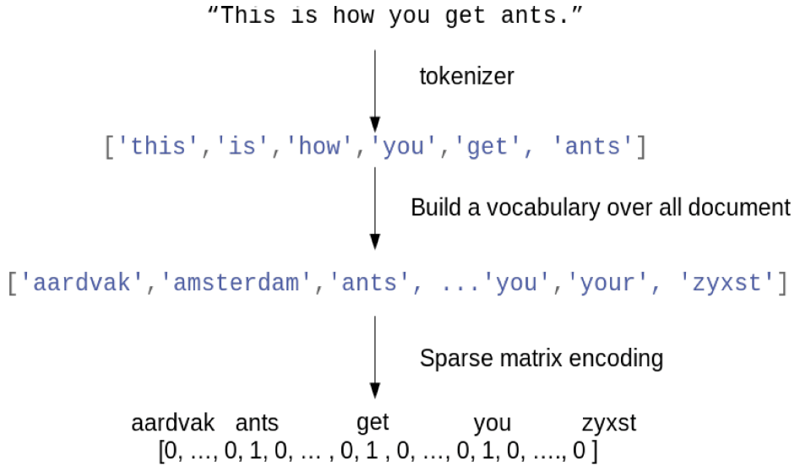
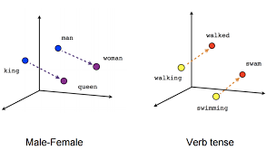
TECHNOLOGY USED - NLP
NLP(Natural Language Processing) - a branch of artificial intelligence concerned with automated interpretation and generation of human language
VECTORIZATION
1. Count Vectorizer
2. TF-IDF Vectorizer
3. Word2Vec Vectorizer

Slide 6
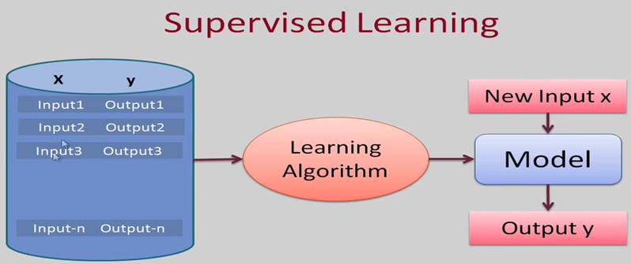
SGD CLASSIFIER
LOGISTIC REGRESSION
NEURAL NETWORKS
NAÏVE BAYES

Slide 7
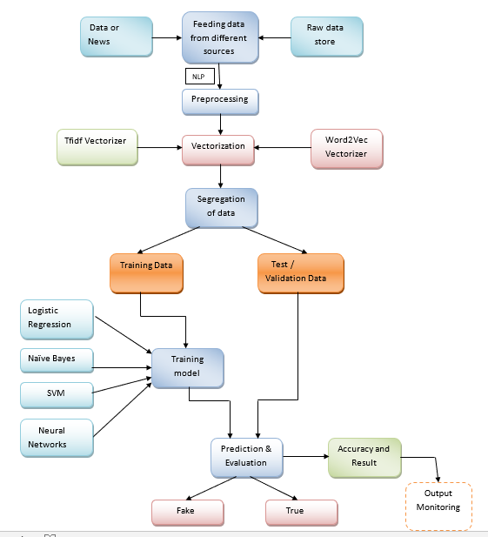
CONCEPT VALIDATION

Slide 8
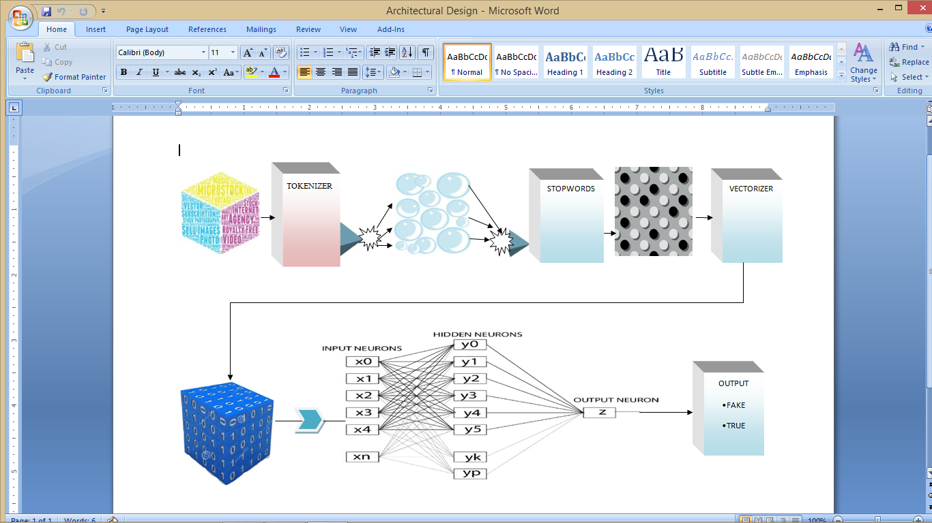

SOLUTION
TO OUR PROBLEM

Slide 9
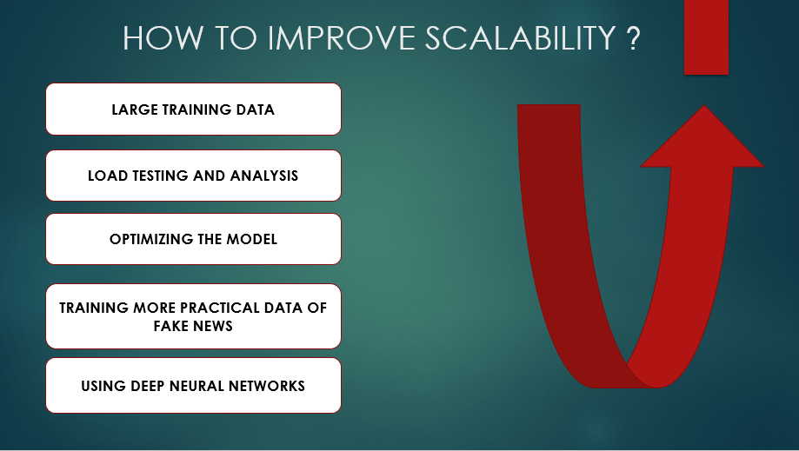

Slide 10
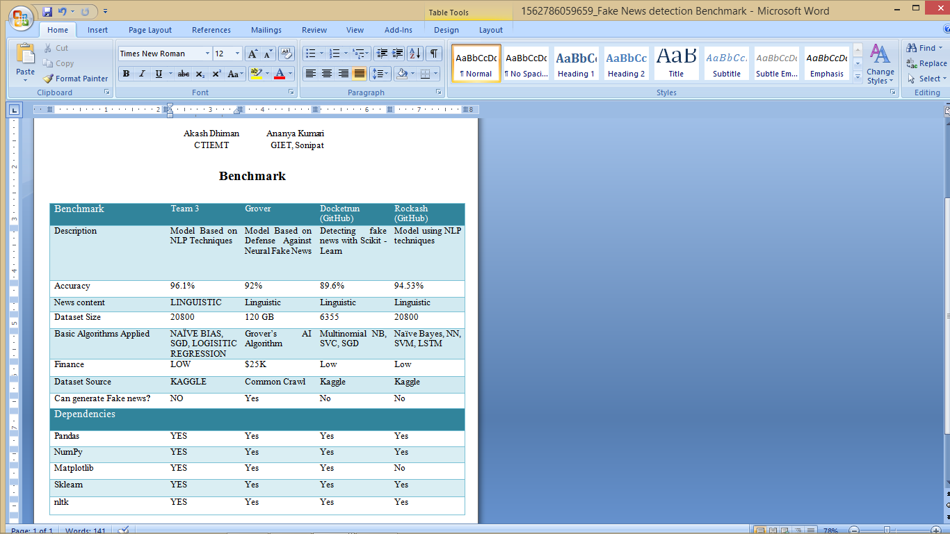
BENCHMARK

Slide 11
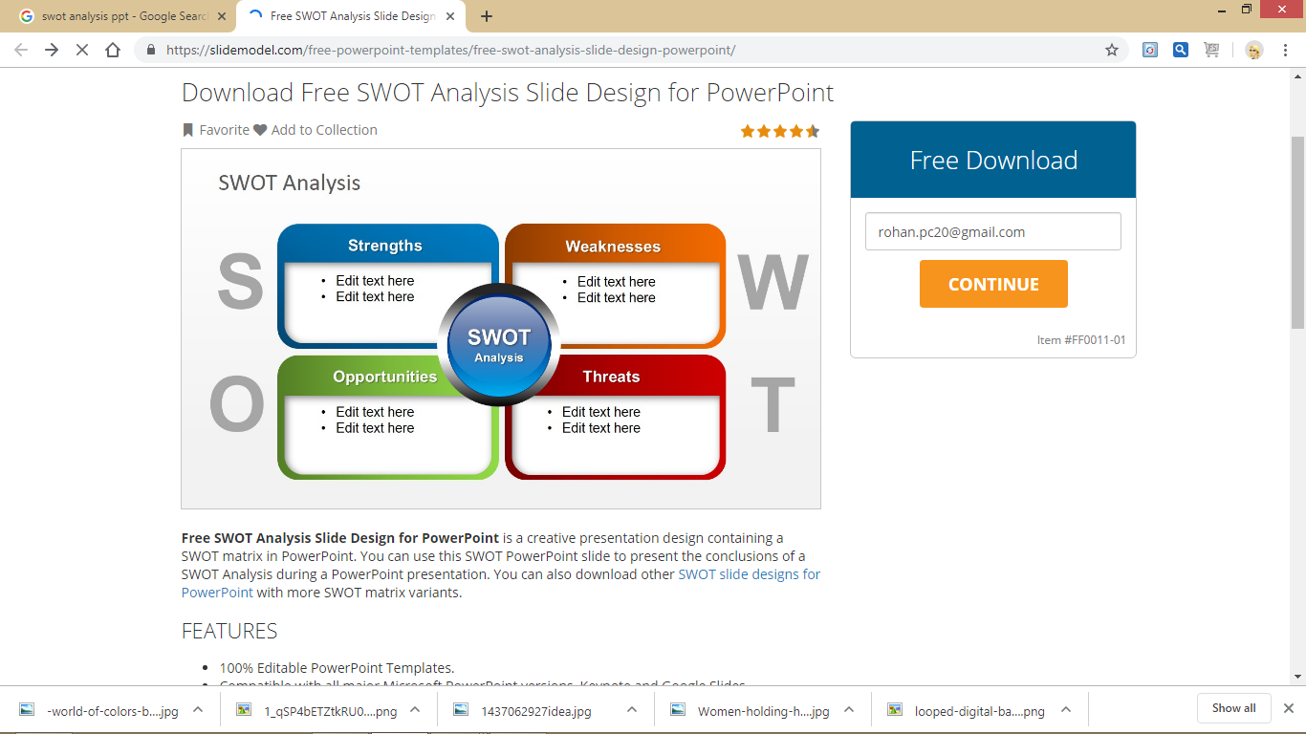
LANGUAGE BARRIER
DATATSETS LIMITED
LOW BUDGET
EFFICIENT
ACCURATE
INCRESING FAKE NEWS
COSTLY COMPETITORS
SIMPLE PIPELINE
LARGE MEMORY FILE OF COMPETITORS
LINGUISTIC AND VISUAL FILE
VARIETY

Slide 12

ESTIMATED COST
SITUATION | COST
ORIGINAL | NULL
WITH IMPROVEMENTS CAN GO UP TO | 25K $

Slide 13
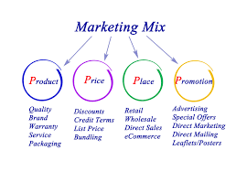
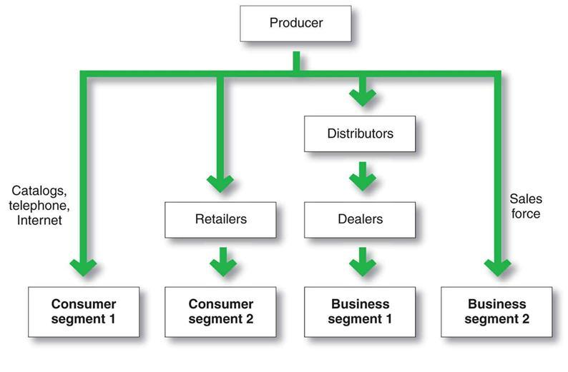

Slide 14


